Slide 1
D-311 Unit 10: Managing Stress
Notes:
Another factor in successful performance as an IADP is the ability to work productively in an environment where stress is common and abundant. Recognizing stressful situations and knowing how you, as an individual respond to stress is the key to managing this demanding environment.

Slide 2
Objectives
Define stress.
List the three categories of stressors.
Describe techniques for responding effectively to stress.
Identify support resources.

Slide 3
What is Stress?
Stress can be defined as a state of worry or mental tension caused by a difficult situation. Stress is a natural human response that prompts us to address challenges and threats in our lives. Everyone experiences stress to some degree. The way we respond to stress, however, makes a big difference to our overall well-being. – The World Health Organization
Acute Stress-
Fight or flight. The body prepares to defend itself.
Chronic Stress-
The cost of daily living: bills, kids, jobs, etc. This is the stress we tend to ignore or push down. Left uncontrolled this stress affects your health.
Over time, chronic stress can lead to symptoms that are physical, psychological or behavioral. One of the psychological effects is known as burnout. Warning signs of burnout are overwhelming exhaustion, cynicism, and a sense of inefficacy. Certain work-related stressors are closely linked with burnout. - Harvard Health Blog By Nicole J. LeBlanc, MA, Contributor, and Luana Marques, PhD, Contributor
You can’t pour from an empty cup.

Slide 4


Three Categories of Stressors
Internal (yourself)
External (environment)
Organizational (dispatch system)

Slide 5
Internal
Something you bring with you and may have the ability to mitigate yourself:
• Exhaustion
• Coworker interaction
• Personal situation

Slide 6
External
Generated by events outside of your personal control:
• Being crowded
• Supervisor
• Location
• Noise
• Shift work

Slide 7
Organizational
Conflicts which are inherent to the dispatch system:
• Multiple tasks that need to be done at the same time.
• Established dispatch ordering procedures.
• Chain of command.
• Authorities and regulations.

Slide 8
Other Examples of Stessors
Ordering an IMT
Handling multiple incidents
Medical situations
Lack of available resources
Long work hours
Abrupt changes is workload

Slide 9
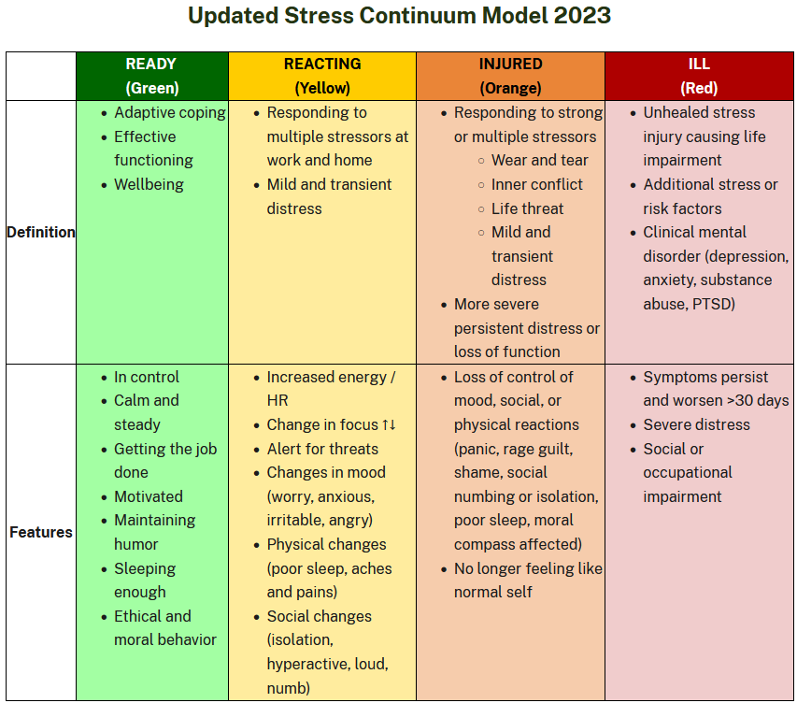
Stress Continuum
Notes:
Color coding simplifies how we talk and understand our stress reactions.

Slide 10
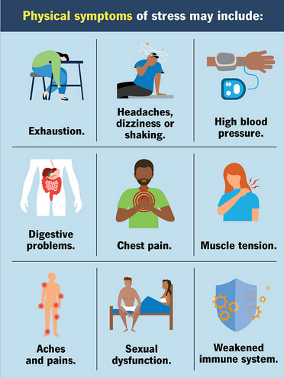
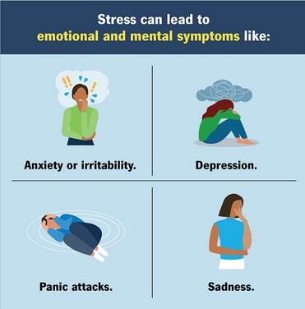
Effects of Chronic Stress
Chronic stress can lead to many long-term health issues affecting your:
Immune system (like arthritis, fibromyalgia and psoriasis).
Digestive system (like weight gain or loss, ulcers and irritable bowel syndrome).
Cardiovascular system (like high blood pressure, increased heart rate and heart palpitations).

Slide 11
Stress Management Techniques
Psychological:
Relaxation strategies help counter the physiological effects of the fight-or-flight response and elicit the relaxation response. These include deep abdominal breathing, focus on a soothing word (such as peace or calm), visualization of tranquil scenes, repetitive prayer, yoga, and tai chi.
Mindfulness is about being fully present in the moment without being overly judgmental, reactive, or overwhelmed by the experience.
Focus on the job
Take breaks
Accept personal limits
Be kind to yourself
Humor

Slide 12
Stress Management Techniques
Physical:
Exercise, such as taking a brisk walk shortly after feeling stressed, not only deepens breathing but also helps relieve muscle tension.
Adequate rest
Eat a well-balanced diet
Take breaks
Environmental:
Develop a social support network
Rotate jobs
Request additional help
Prioritize tasks
Communicate with your supervisor
Be organized
Spend time outdoors
Stress Management is a PRACTICE!

Slide 13
Responding Effectively to Stressful Situations
When should I talk to a healthcare provider about stress?
You feel overwhelmed or unable to cope.
Your physical health is affected.
Symptoms of stress aren’t going away with stress relief techniques.
Reliance on alcohol or other substances to cope.
If you experience any of these please seek medical care.

Slide 14
You can’t always control the situation, but you can control how you react.
Stress cannot be eliminated, but it can be managed.

Slide 15
Support
Federal Agency Employee Assistance Programs
National Interagency Wildland Fire Critical Incident Stress Management Website

Slide 16


Slide 17
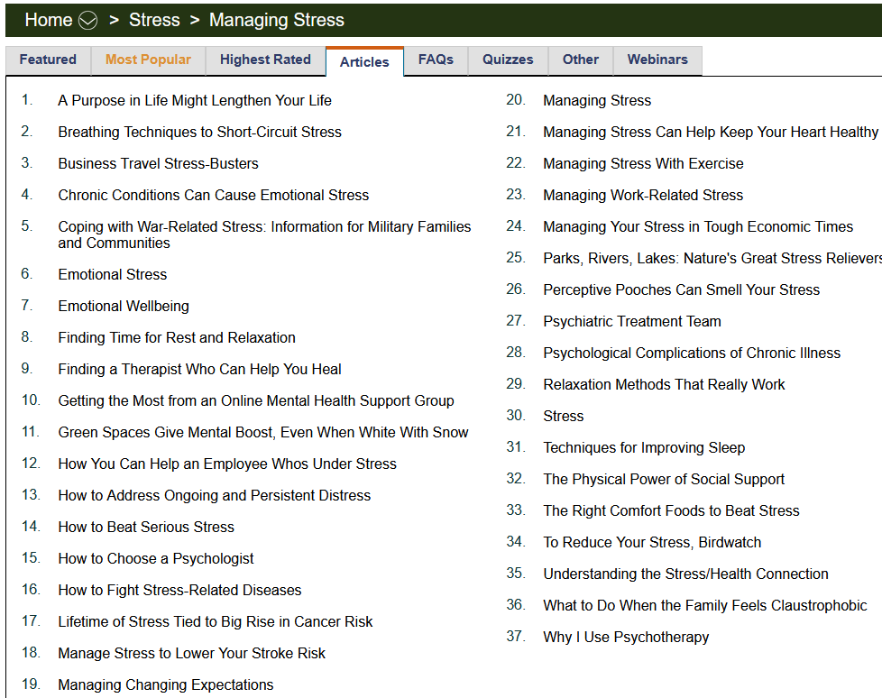
EAP Example
Employee Assistance Programs- The Department of the Interior (DOI) agencies and the Forest Service have assistance programs that will help with personal or work-related problems. These resources are available to ALL employees and their families. Families may continue to use the EAP for up to six months after separation from employment.

Slide 18
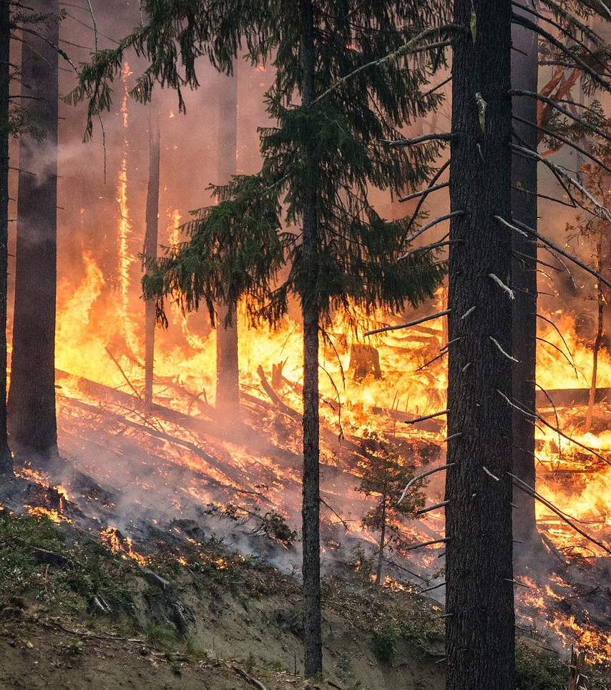
Activity
One topic per group that will be presented to the class. Be creative and be specific.
Describe 10 stress management techniques that can be done daily.
Describe 10 psychological stress management techniques.
Describe 10 physical stress management techniques.
Describe a moment of awe. Awe helps to build resilience and calms the limbic system.

Slide 19
Summary
Nothing can bring you peace but yourself.
Ralph Waldo Emerson
Notes:
Guides and Key
The presentations and instructor guides include notes to aid facilitators in instruction.
Key
Indicates an action for the instructor to take.
Indicates topics and information for the facilitator to use as they see fit.
Example Notes
Review unit objectives.
Exercise
Advise participants that the next few slides will introduce common terms that describe parts of a fire.
Pre-Video Discussion
In this scenario, firefighters have arrived on scene of a new fire. They are gathering and communicating their situational awareness of the current fire behavior.
Play Video
Title Basic Fire Terminology
Summary State the summary
Time (02:20)
Audio
Post-Video Discussion
This unit will discuss many of these terms in more detail.
Question: Identify this fire behavior.
Answer: Torching
Note to Instructor
The fuel types listed on this slide will be discussed in detail in Unit 2.
List Level 1
List Level2
Example
Example
List Level 1
List Level 1

Slide 20
Objectives
Define stress.
List the three categories of stressors.
Describe techniques for responding effectively to stress.
Identify support resources.

